Slide 1

Climate Change
Group 10

Slide 2
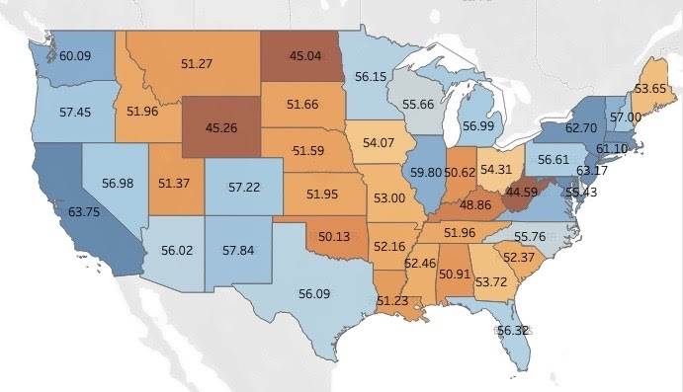
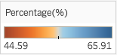
Public Opinion
57% of American believe climate change caused mostly by human activities
Less people in middle part of the U.S. agree with the statement.
Data from Yale’s American Mind project

Slide 3

Temperature and Disasters

Slide 4
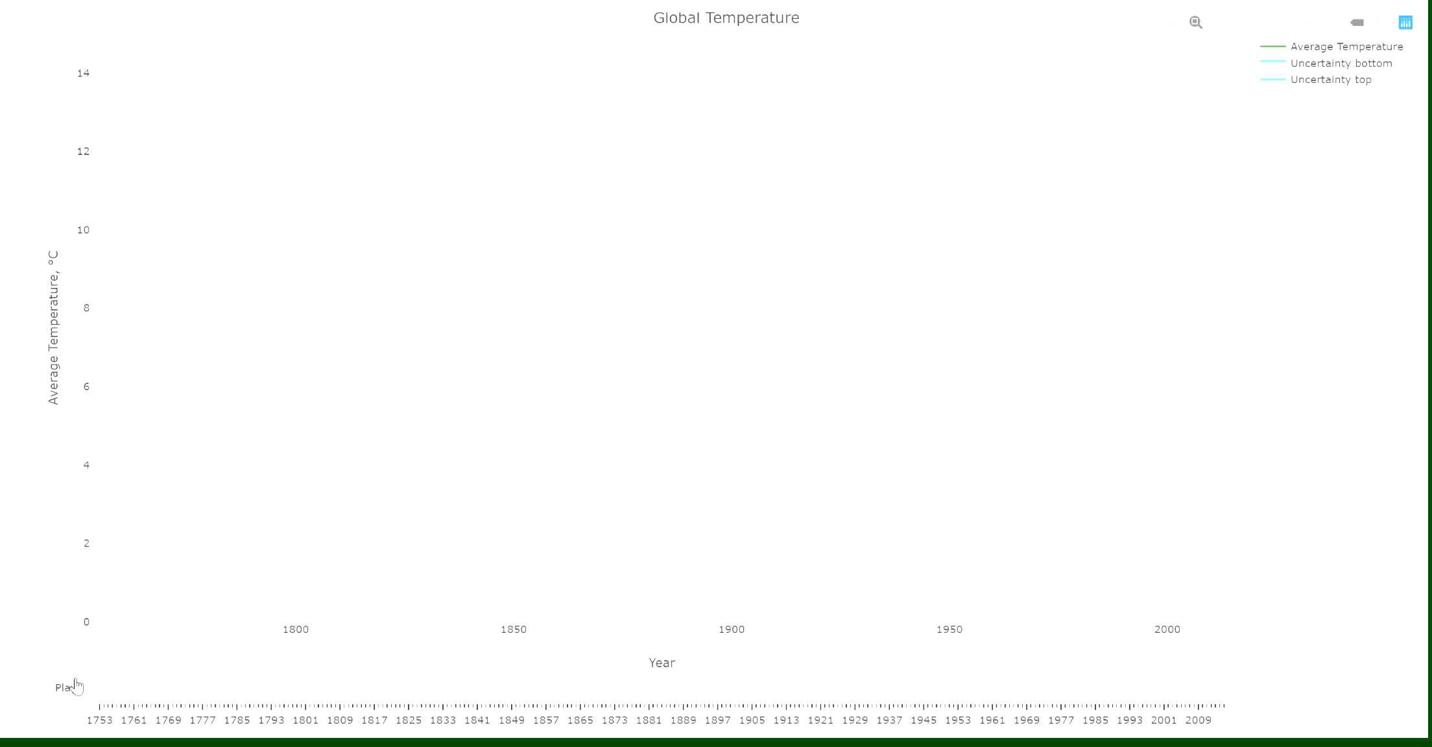
Data from Berkeley Earth

Slide 5
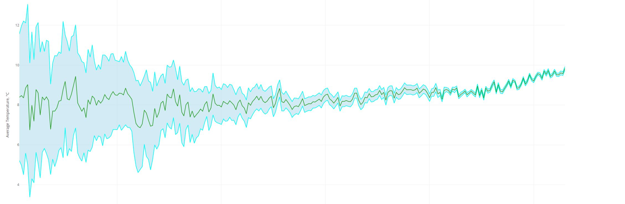
Global Temperature Trend
2015
1940
1880
Massive use of fossil fuel
The Population Explosion
The Globalized Industrialization
Data from Berkeley Earth

Slide 6
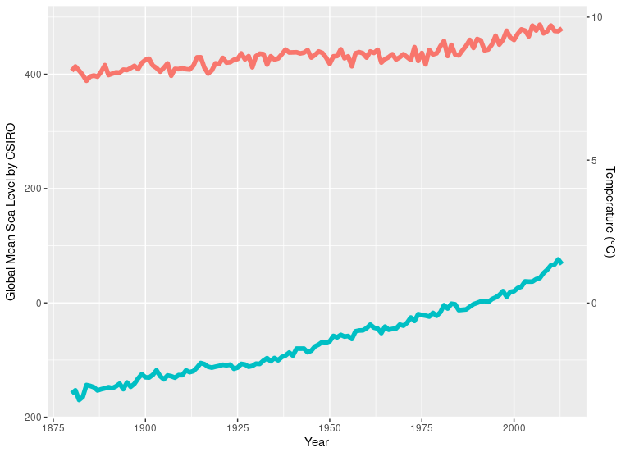
Temperature and Disasters
the global mean sea level has raised about 241.55 mm
More than 60% of raising happens after 1940
This could mainly be related to melting inner-land glaciers
Temperature
Sea level
Data from Commonwealth Scientific and Industrial Research org
Notes:
Data source: https://datahub.io/core/sea-level-rise#resource-csiro_recons_gmsl_mo_2015
GMSL: Global Mean Sea Level in mm

Slide 7
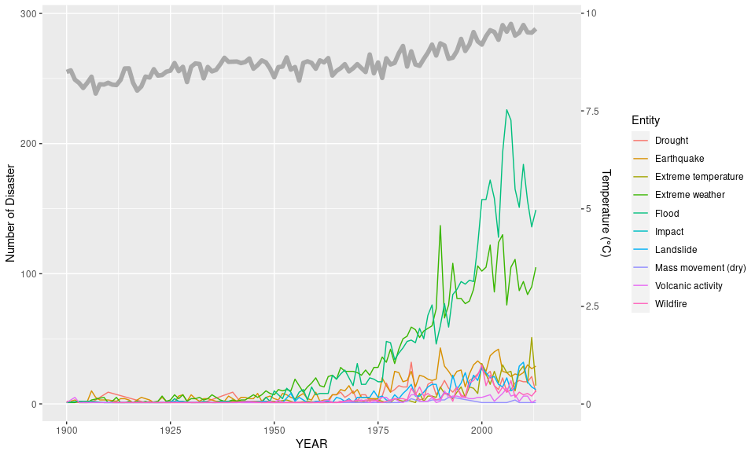
Temperature and Disasters
Through 1940 to 2018, the frequency of almost every kinds of natural disasters had increased
Among them, flood and extreme weather changing are the most noticeable
Data from OFDA/CRED International Disaster Database
Notes:
Data source: https://www.kaggle.com/dataenergy/natural-disaster-data and https://ourworldindata.org/natural-disasters

Slide 8

Emission Study

Slide 9
Our Dataset is a Combination of Two
The PRIMAP-hist national historical emissions time series (1850 – 2017)
Source Organization: Postdam Institute For Climate Impact Research
The GHG emission data was draw from this dataset
The Global Temperatures dataset (1750 – 2015)
Source Organization: Berkeley Earth
The global average temperature data was draw from this dataset

Slide 10
Data Cleaning and Grouping
Using R dyplr package to inner join the datasets by year (1850 - 2015)
Data Cleaning
In global temperatures dataset, only use removed 12 NA values, convert monthly temperatures to annual average temperatures using group_by
In PRIMAP-hist national historical emissions time series, removed non-relevant texts
Data Structure:
After cleaning, the data structure is 166 * 18; Before cleaning, 3192 * 25
Data Type:
Integers and Numeric, and Date type

Slide 11
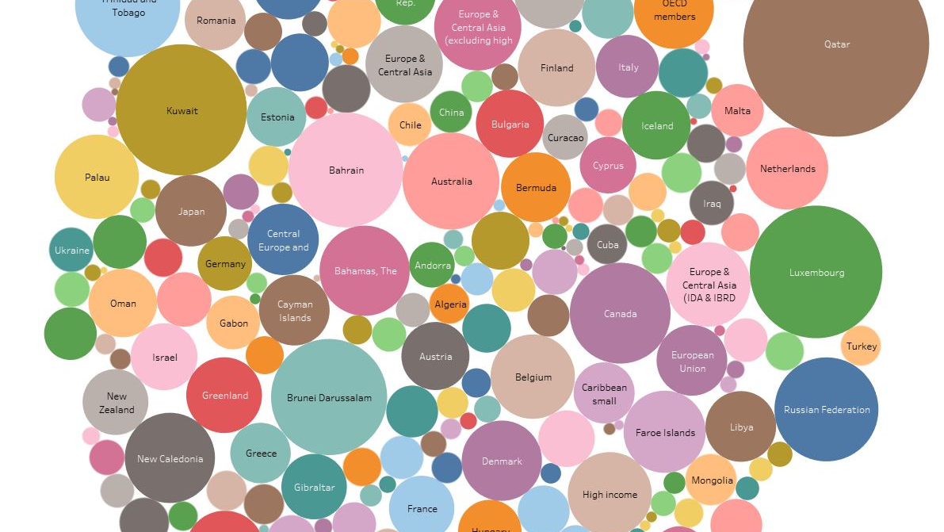
Visualization
Notes:
Tableau public link: https://public.tableau.com/views/CO2perCapDashboard/CO2percapdashboard?:language=en&:display_count=y&publish=yes&:origin=viz_share_link

Slide 12
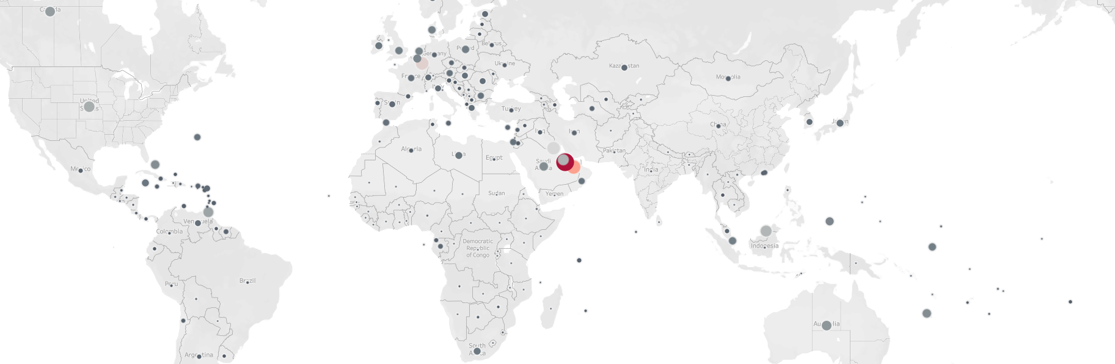
Map Visualization
Both the size and the color shows the cumulated CO2 emission per capita
Petroleum exporting countries and developed countries have higher CO2 emission per capita
Notes:
The per capita visualization used the population number from the world bank
Tableau public link: https://public.tableau.com/views/CO2perCapDashboard/CO2percapdashboard?:language=en&:display_count=y&publish=yes&:origin=viz_share_link

Slide 13
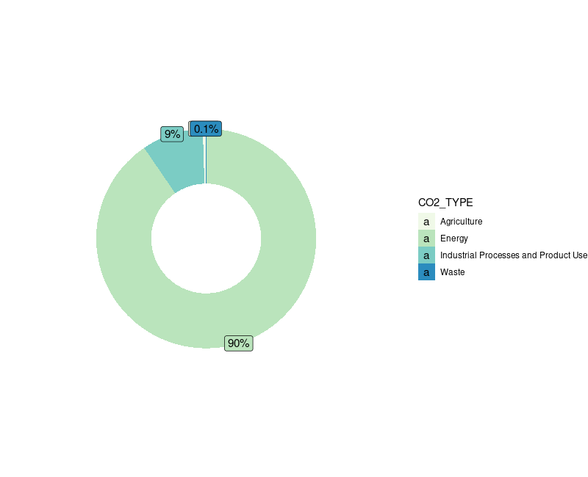
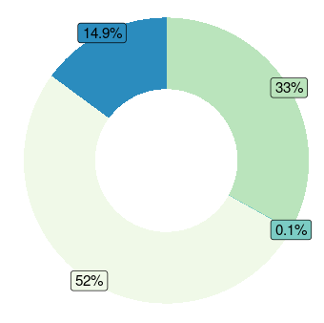
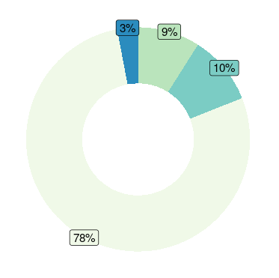
Greenhouse Gases Origin
N20
Most of the CH4 and CO2 came from Agriculture sector
CH4
CO2

Slide 14
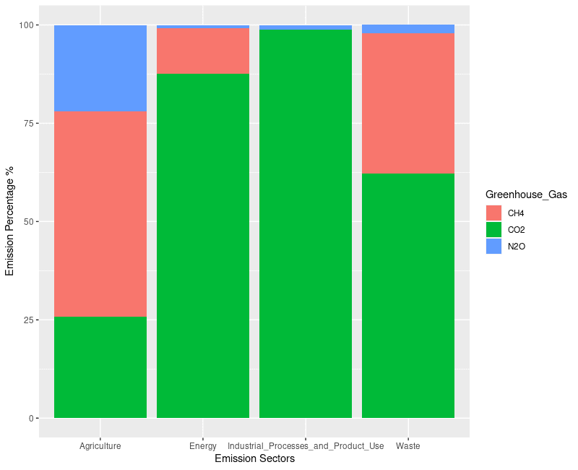
Sectors’ Emission
Agriculture sector produce balanced proportion of GHGs.
The Energy and Industrial Processes and Product Use sectors mostly produce CO2.
Waste sector produce CO2 and CH4 but not too much N2O

Slide 15
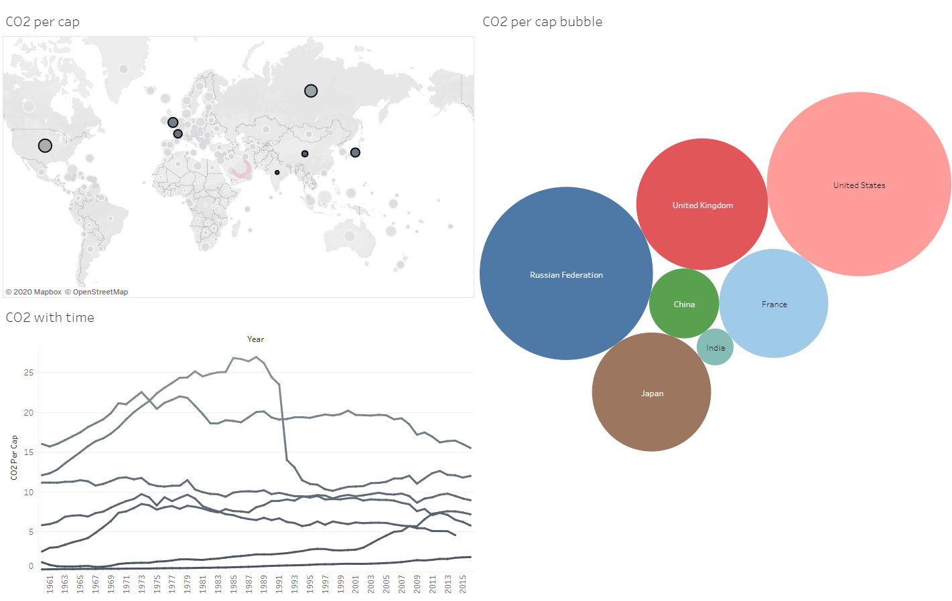
Predictive Analytics

Slide 16
Feature Engineering and Selection
We care about the increasing of global temperature, hence the predictive variable was set at “global average temperature”
We picked four most famous greenhouse gas (GHG) as the features:
Carbon Dioxide (CO2)
Methane (CH4)
Nitrous Oxide (N2O)
Fluorinated Gasses
Each of the GHG was categorized according to its origin:
Energy
Industrial Processes and Product Use
Agriculture
Waste

Slide 17

Model Design
5 Models:
Generalized Linear Model (glm)
Boosted Regression Model (glmboost)
Random Forest (rf)
Linear Least Squares (lm)
Stepwise Selection (glmStepAIC)
Apply 10-fold Cross-Validation on each of them to check:
Root Mean Square Error (RMSE)
R squared
Mean Absolute Error (MAE)

Slide 18

Comparison between Models
Models | Root Mean Square Error (RMSE) | R squared | Mean Absolute Error (MAE)
Generalized linear model | 0.1039126 | 0.8806361 | 0.08591636
Boosted regression model | 0.1257597 | 0.8308088 | 0.1027235
Random Forest | 0.09173089 | 0.9083568 | 0.07243502
Linear least squares | 0.1055907 | 0.8862334 | 0.08714464
Stepwise Selection | 0.1067489 | 0.8577271 | 0.08862704
Random Forest won all 3 sections

Slide 19
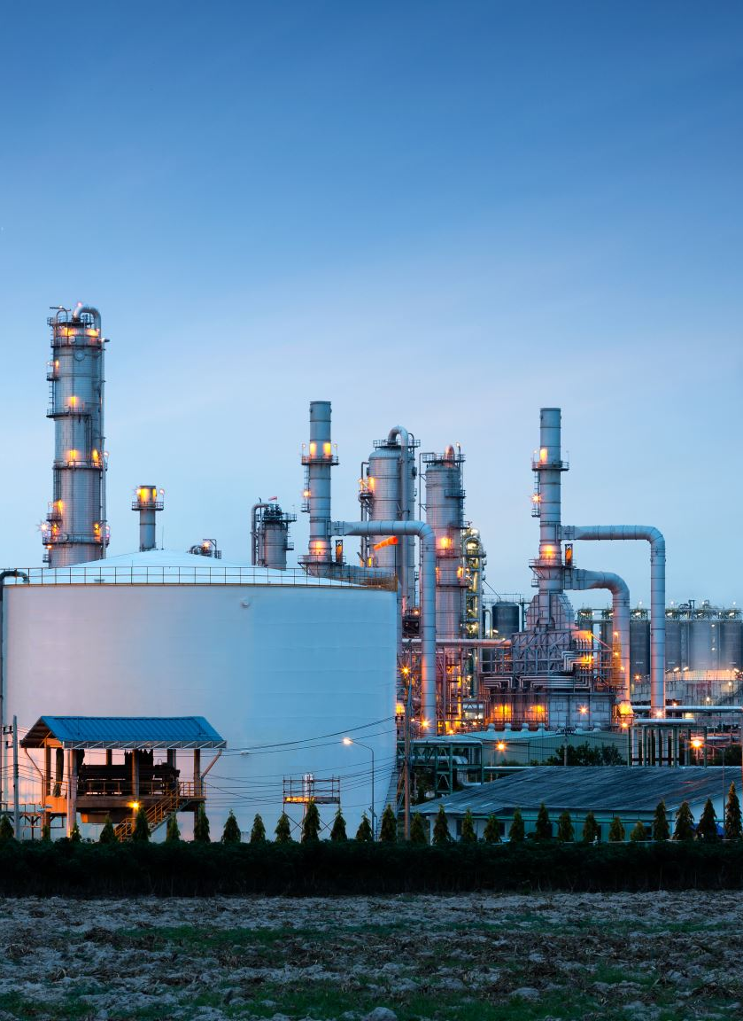
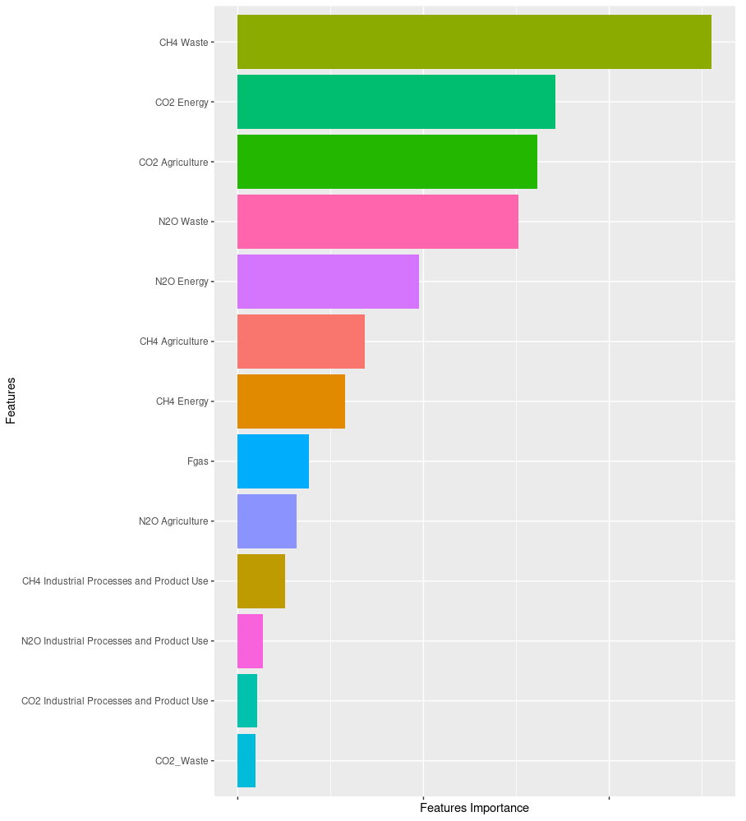
waste
Features Importance from Random Forest Model

Slide 20
Important Features and Conclusions
Agriculture
Energy
Waste

Slide 21

SUM UP

Slide 22

Recommendations
Education
Agriculture technology
Buy and eat when you need

Slide 23

Thank you

